Slide 1
Modules
Guoqiang Zhang
Reference book: “Introduction to Python Programming Course Notes”, Phil Spector, University of California Berkeley

Slide 2
Introduction of Modules and Packages
A module is a single python file which contains predefined functions and/or other objects.
Any Python file is a module
A package is a collection of modules in directories that give a package hierarchy.
Similar to libraries in C language
Various packages are available that provide tones of functions to facilitate Python programming
Packages have to be installed separately.
For example, the package “numpy” can be installed by running pip install numpy
The command ”pip list” can be run to check what packages have been installed.

Slide 3
Popular packages
Numpy: A package for scientific computing
SciPy: A package for scientific computing
matplotlib: A package for visualization
cv2: A package for computer vision
pytorch: A package for deep learning (Facebook uses it).
tensorflow: A package for deep learning, maintained by google.
Remark: Packages may introduce new data types in addition to the basic ones

Slide 4
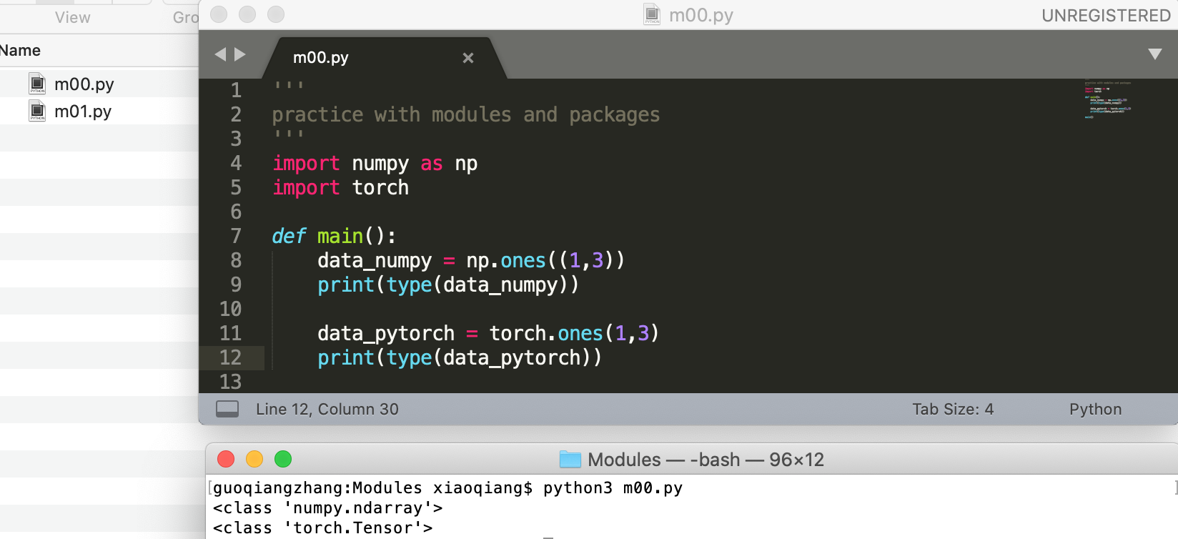
Popular packages
A sample code

Slide 5
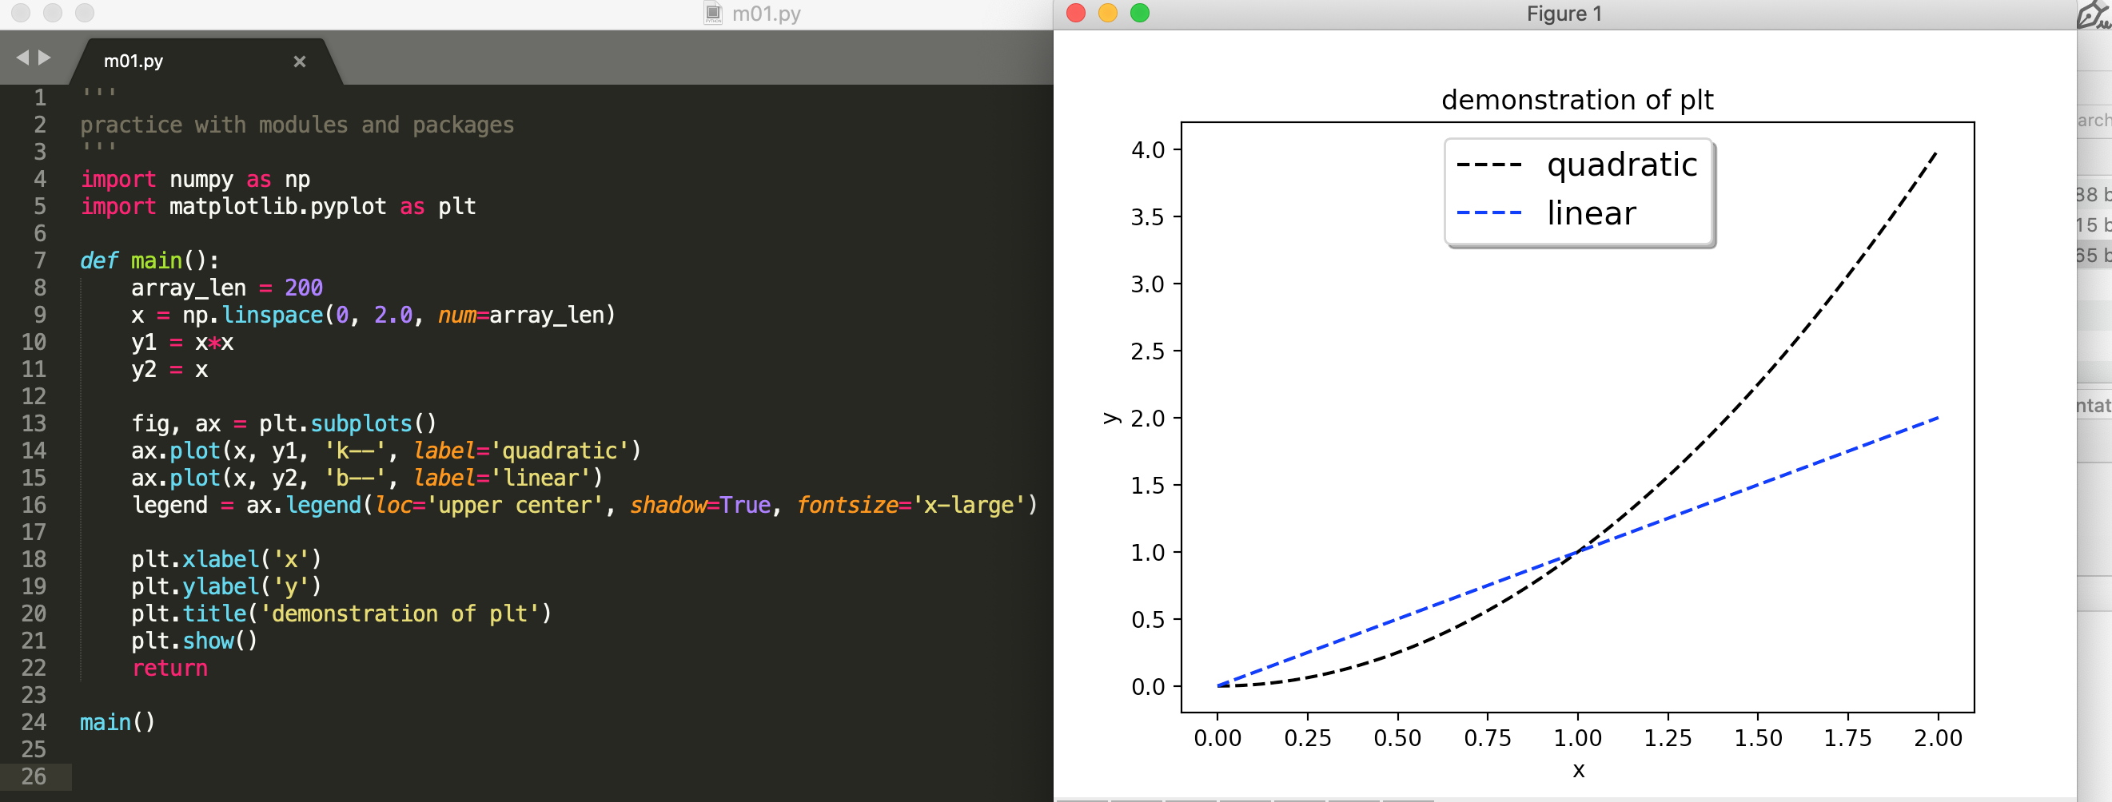
Example 1 of using matplotlib and numpy
Keyword “import” is used to import either a packet or a module
Remark: Packages need to be installed seperately.

Slide 6
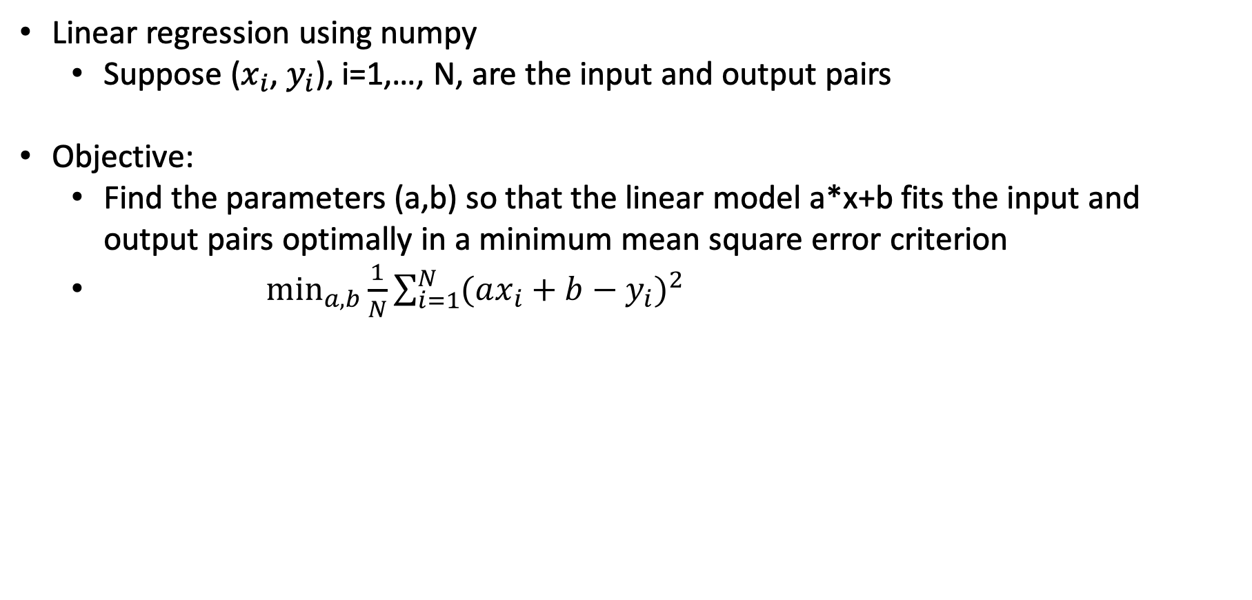

Example 2 of using matplotlib and numpy
Linear regression using numpy
Suppose ($x_{i}$, $y_{i}$), i=1,…, N, are the input and output pairs
Objective:
Find the parameters (a,b) so that the linear model a*x+b fits the input and output pairs optimally in a minimum mean square error criterion
$\min_{a,b}\frac{1}{N}{\sum_{i=1}^{N}{{(ax_{i}+b−y_{i})}^{2}}}$
$$\left(\begin{matrix}a \\ b\end{matrix}\right)={\left(\begin{matrix}\sum{x_{i}x_{i}} & \sum{x_{i}} \\ \sum{x_{i}} & \sum{1}\end{matrix}\right)}^{−1}\left(\begin{matrix}\sum{y_{i}x_{i}} \\ \sum{y_{i}}\end{matrix}\right)$$

Slide 7
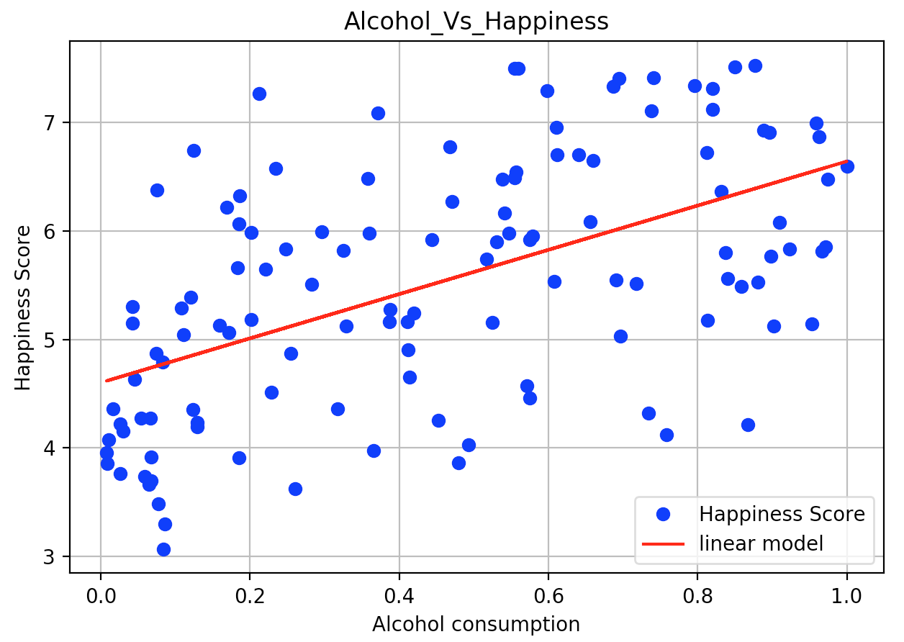
Example 2 of using matplotlib and numpy
Numpy allows for various matrix operations in linear algebra
E.g., matrix multiplication, matrix inversion, matrix concatenation
See m03.py for an example on linear regression using numpy and matplotlib

Slide 8
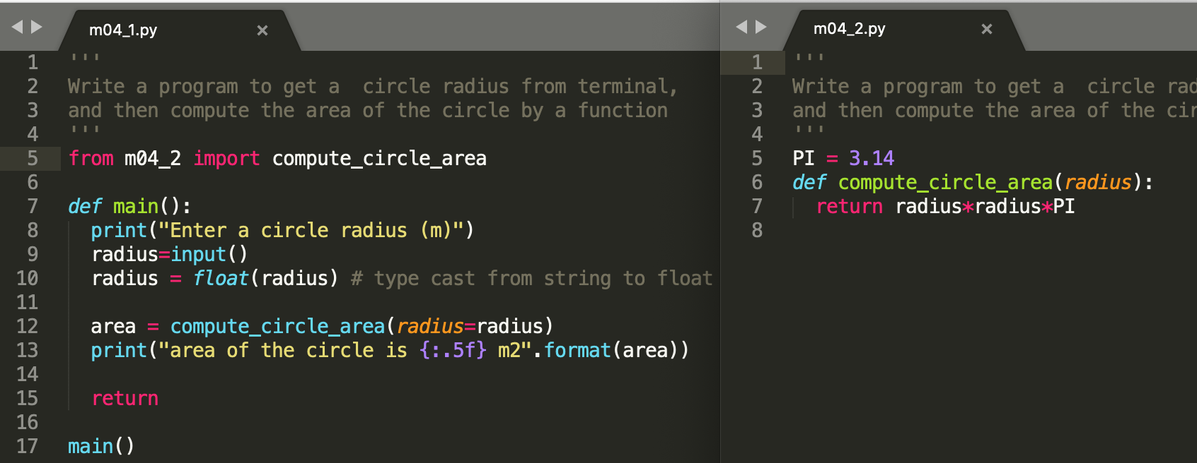
Demonstration of user-defined modules
One can still use “import” to import a user-defined module

